Slide 1

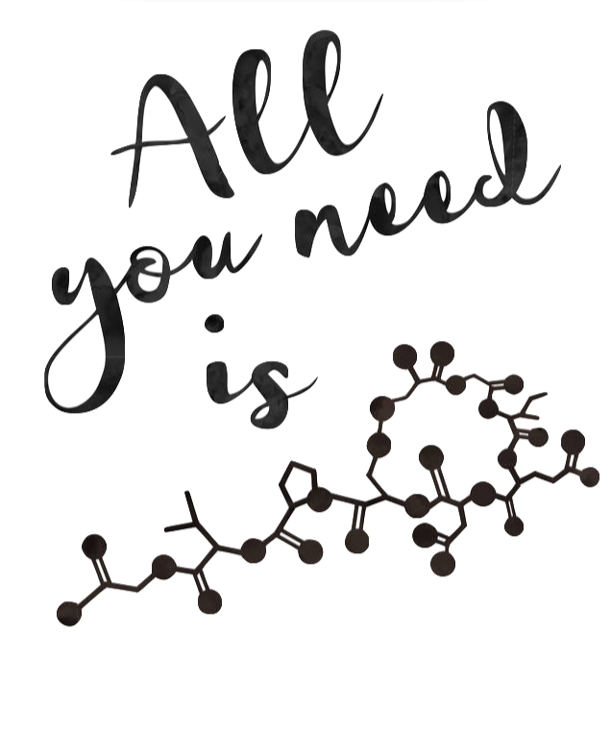


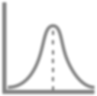


REACTION INTERMEDIATE
JEETENDRA k ARYA 7077 6066 22
FEEEBEat

Slide 2
Free-radical
NOTE :-
Genration of Free-Radical
By Metal, Metal-Salts, Heat, Electricity, Sunlight, Peroxide Radical itself generate free-radical .
Mr. H E L P E R will help you to do free- radical reaction.
TRICK :-
WURTZ COUPLING REACTION
2 R-X + 2 Na + (Dry Ether)
FITTIG COUPLING REACTION
2 Ph-Cl + 2 Na + (Dry Ether)
—————> R-R + NaCl
—————> Ph-Ph + NaCl
3. WURTZ FITTIG COUPLING REACTION
R-X + Ph-X + Na + (Dry Ether)
4. FRANK LAND
2 R-X + Zn (Dry Ether)
—————> R-R + Ph-Ph + Ph-R + 2NaX
—————> R-R + ZnX2
5. ULLMANN BIPHENYL REACTION
2 Ph-I + Cu (Dry Ether) —————> Ph-Ph + CuCl2
6. KOLBE’S ELECTROLYSIS
R-COO-Na + Electricity + (H2O) —————> R-R + 2 CO2 + 2 NaOH + H2
PINACOL FORMATION
2 CH3-CHO + Mg (Hg) + (Dry Ether ) + H3O⁺ ————> CH3-CH(OH)-CH(OH)-CH3
ACYLOIN CONDENSATION
R-CO-OR + 2 Na (Hg) + (Dry Ether) + H3O⁺
R—C(OH)=C(OH)—R + tautomerism
9. PHOTO HALOGENATION
————> R—C(OH)=C(OH)—R
————> R—CO—C(OH)(H)—R
R—H + X2 + Sunlight —————> R—X + HX
ALLYLIC SUBSTITUTION
C = C—C + Br2 Limited + (250⁰C) —————> C = C—C—Br + H-Br
NOTE:- NBS is also used in allylic substitution
BORODINE HUNDIECKER REACTION
R—COO⁻Ag⁺ + Br2
12. SIMONINI REACTION
R—COO⁻Ag⁺ + I2
NOTE:- This alkyl
—————> R—Br + CO2
—————> R—CO—O—R
(ESTER)
group should be bulky or
₃o
MENTOR :- JEETENDRA ARYA
MOB :- 7077 6066 22

Slide 3
CarboCation
NOTE :- Generation of Carbocation
By Heterolytic fission of Sigma bond
By Heterolytic fission of Pi bond By Diazotisation
(3⁰carbon, good LG & Polar solvent) ( Electrophile will break Pi bond ) ( NaNO2 + dil. HCl with 1º Amine )
DEHYDRATION OF ALCOHOL
CH3—CH2—OH + conc. H2SO4 + heat (170⁰C) —————> C = C + H2O CH3—CH2—OH + conc. H2SO4 + heat (140⁰C) —————> C—C—O—SO4H CH3—CH2—OH + conc. H2SO4 + heat (110⁰C) —————> C—C—O—C—C
NOTE :- Concentrated H2SO4 dehydrate the alcohol but diluted H2SO4 hydrate the alkene.
Function of Concn H2SO4 = Concn H3PO4 = Al2O3 + heat = P2O5 + heat
PINACOL PINACOLONE REARRANGEMENT
R—C(OH)(R’)—C(OH)(R”’)—R” + conc. H2SO4 ———> R—CO—C(R’)(R’’’)—R”
ELECTROPHILIC ADDITION OF HALO ACID WITH ALKENE
C = C + H-X C—C = C + H-Br
C—C = C + H-Br + (H2O2) C—C = C + H-Cl + (H2O2)
——————>
——————>
——————>
——————>
CH3—CH2—X CH3—CH(Br)—CH3 CH3—CH2—CH2—Br CH3—CH(Cl)—CH3
NOTE :- Peroxide Effect only shown by HBr and it follows free-radical Mechanism because of Hydrogen Peroxide .
ELECTROPHILIC ADDITION IN CONJUGATED DIENES
C = C—C = C + H-Br + (+40⁰C / TCP) —————> C—C = C—C—Br C = C—C = C + H-Br + (-80⁰C / KCP) —————> C—C(Br)—C = C
High Temperature favours Thermodynamic product , which means stable product . Low Temperature favours Kinetic product , which means stable intermediate .
ELECTROPHILIC ADDITION OF WATER WITH ALKENES
C—C = C + H2O + H⁺ ——————> C—C(OH)-C
C—C =C + Hg(OAc)2 + H2O + NaBH4 + Et2O ———————>
Oxymercuration Demercuration
C—C(OH)-C
C—C =C + BH3 + THF + H2O2
+ ⁻OH ———————> C—C—C(OH)
Hydroboration Oxidation
NOTE :- THREE NINJA TECHNIQUE TO ADD WATER ACROSS DOUBLE BOND
CATAYLATIC HYDRATION = MARKONIVOFF WITH REARRANGEMENT ( not stereoselective because carbocation is formed )
OM-DM REACTION = MARKONIVOFF WITHOUT REARRANGEMENT ( anti addition of H+ & OH- )
HBO REACTION = ANTI-MARKONIVOFF WITHOUT REARRANGEMENT ( syn addition of H+ & OH- )
ELECTROPHILIC ADDITION OF X2 / CCl4 WITH ALKENE C = C + Br2 + CCl4 ——————> C—(Br)—C—Br
Non-polar
ELECTROPHILIC ADDITION OF X2 / H2O WITH ALKENE C = C + Br2 + H2O ——————> Br—C—C—OH
Polar
MENTOR :- JEETENDRA ARYA
MOB :- 7077 6066 22

Slide 4


CARBANION
1. GRIGNARD REAGENT AS BASE
CH3-Mg-Br | + | H2O | —————> | CH4 + | Mg-(Br)(OH)
CH3-Mg-Br | + | CH3OH | —————> | CH4 + | Mg-(Br)(O-CH
3)
CH3-Mg-Br CH3-Mg-Br CH3-Mg-Br | + + + | PH-OH CH3-COOH CH3-CO-CH2-CO-C | —————> —————> H3 ———-> | CH4 CH4 CH4 | + Mg-(Br)(O-Ph) + Mg-(Br)(O-CO-CH3) + CH3-CO-CH(Mg-Br)-CO-CH3
CH3-Mg-Br | + | Non-Aromatic comp ————> CH4 + Quasi Aromatic Comp of Mg
CH3-Mg-Br | + | NH3 —————> CH4 + Mg-(Br)(NH2)
CH3-Mg-Br | + | CH3-NH2 —————> CH4 + Mg-(Br)(NH-CH3)
CH3-Mg-Br | + | (CH3)2-NH —————> CH4 + Mg-(Br)(N-(CH3)2)
CH3-Mg-Br | + | (CH3)3-N —————> No Rxn
CH3-Mg-Br | + | CH3-CH3 —————> No Rxn
CH3-Mg-Br | + | H2C=CH2 —————> No Rxn
CH3-Mg-Br CH3-Mg-Br CH3-Mg-Br | + + + | Terminal Alkyne CH3-CO-NH2 H-CN | —————> —————> —————> | CH4 CH4 CH4 | + Mg-(Br)(CCH) + Mg-(Br)(NH-CO-CH3) + Mg-(Br)(CN)
2. GRIGNARD AS NEUCLEOPHILE
2a. GRIGNARD WITH CARBONYL COMPOUND
CH3—Mg—Br + H—CO—H CH3—Mg—Br + CH3—CO—H CH3—Mg—Br + CH3—CO—CH3
—————> CH3—CH2—OH
—————> (CH3)2—CH—OH
—————> (CH3)3—C—OH
1⁰ Alcohol
2⁰ Alcohol
3⁰ Alcohol
2b. GRIGNARD WITH ACID DERIVATIVE
CH3—Mg—Br + CH3COOH CH3—Mg—Br + CH3—CO—OR CH3—Mg—Br + CH3—CO—Cl
—————> CH4
—————> CH3—CO—CH3
—————> CH3—CO—CH3
+ Mg(Br)(O-CO-CH3)
+ Mg(Br)(O-R)
+ Mg(Br)(Cl)
+ Mg(Br)(O-CO-R)
+ Mg(Br)(NH)—CO—CH3
CH3—Mg—Br + Acid Anhydride —————> CH3—CO—CH3 CH3—Mg—Br + CH3—CO—NH2 —————> CH4
2c. GRIGNARD WITH CYCLIC ETHER
—————>
—————>
—————>
—————>
NO REACTION CH3—CH2—CH2—OH CH3—CH2—CH2—CH2—OH NO REACTION
CH3—Mg—Br + CH3—Mg—Br + CH3—Mg—Br + CH3—Mg—Br +
CH3-O-CH3
Cyclic Ether (3 Member)
Cyclic Ether (4 Member) Cyclic Ether (5 Member)
2d. GRIGNARD WITH OXIDE AND SULPHIDE CH3—Mg—Br + O=C=O —————> CH3COOH CH3—Mg—Br + S=C=S —————> CH3—CS—SH CH3—Mg—Br + O=S=O —————> CH3—SO—OH CH3—Mg—Br + SO3 —————> CH3—SOO—OH
2e. GRIGNARD WITH HALOGENS
CH3—Mg—Br + F—F CH3—Mg—Br + Br—Br CH3—Mg—Br + Cl—Cl CH3—Mg—Br + I—I CH3—Mg—Br + CH3—Br
—————>
—————>
No Reaction CH3—Br CH3—Cl CH3—I CH3—CH3
+ MgBr2
+ MgBrCl
+ MgBr-I
+ MgBr2 MgBr2
—————>
—————>
—————>
CH3—Mg—Br + Br-CH2-Ph-CH2-Br ———> CH3-CH2-Ph-CH2-Br +
2f. GRIGNARD WITH CYANIDE AND SUBSTITUTED CYANIDE
CH3—Mg—Br + H—CN CH3—Mg—Br + Cl—CN CH3—Mg—Br + NC—CN CH3—Mg—Br + CH3—CN
—————> CH4
—————> CH3—CN
+ Mg(Br)(CN)
+ Mg(Br)(Cl)
+ Mg(Br)(CN)
—————> CH3—CN
—————> CH3—CO—CH3 + Mg(Br)(OH) + NH3
MENTOR :- JEETENDRA ARYA
MOB :- 7077 6066 22

Slide 5

3. COREY—HOUSE SYNTHESIS
(CH3)2—Cu⁻ Li⁺ + R`—X
(Gilmann`s Reagent)
——————>
CH3—R` + CH3-Cu + Li-X
SODA LIME DECABOXYLATION
R-COOH + NaOH + CaO + Heat —————>
2 R-COOH + Ca(OH)2 —————>
HEATING EFFECT
5a. HEATING EFFECT OF B-KETO-ACID
R-H + CaCO3
R-CO-R + CaCO3
R-CO-CH2-COOH + Heat —————> R-CO-CH3 + CO2
5b. HEATING EFFECT OF GEM - DICARBOXYLIC ACID HC(R)(COOH)2 + Heat —————> R-CH2-COOH
5c. HEATING OF DICARBOXYLIC ACID BLANC’S RULE
0,1
2,3
4,5
+ Heat —————> CO2
+ Heat —————> H2O
+ Heat —————> (H2O + CO2)
6,more + Heat —————> Inter-Molecular Reaction
O M S G A P S
6. HYDROLYSIS
6a. HYDROLYSIS OF CYANIDE
Cyanide + Partial Hydrolysis
—————>
Acid Amide Carboxylic Acid
Cyanide + Complete Hydrolysis —————>
6b. HYDROLYSIS OF ETHER
—————>
—————>
R-OH + R’-OH NO REACTION
Ethers + H3O⁺
Ethers + OH⁻
Basic hydrolysis is not \possible for Ethers
6c. HYDROLYSIS OF ESTER
Ester + Basic Acidic
_{H}+
+ H2O
—————>
of Ester is of Ester is
Carboxylic Acid + Alcohol called Saponification called Esterification
Hydrolysis Hydrolysis
NOTE :- Genration of Carbanion
By Organomettalic compound By Base + very strong heat By Heating Effect
MENTOR :- JEETENDRA ARYA
MOB :- 7077 6066 22

Slide 6
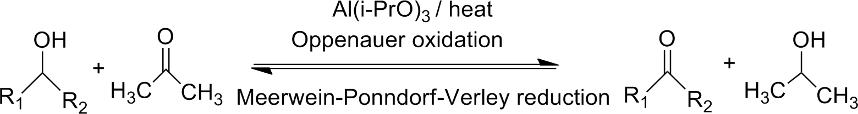

OXIDATION
NOTE :- Alkene/Alkyne —> Alcohol —> Carbonyl —> Carboxylic acid
REDUCTIVE OZONOLYSIS
R-CH=C(R)2 + O3 + Zn / (CH3)2S —————>
OXIDATIVE OZONOLYSIS
CH3-CH=C-(Me)(Et) + O3 + H2O2 / Ag2O ————>
BAEYER VILLIGER OXIDATION
R-CO-R` + CH3-COOOH —————>
This oxidation only work for ketone .
R-CHO + R-CO-R + ZnO
CH3-COOH + CH3-CO-Et
R-CO-O-R`
4. OXIDATION OF ALKENE WITH PEROXY ACID
CH3-CH=CH-CH3 + CH3-COOOH —————> [2,3] EPOXY BUTANE
5.
COLD, DIL. , ALKALINE KMnO4 (BAEYER`S REAGENT)
CH3-CH=CH-CH3 + KMnO4 —————> CH3-CH(OH)-CH(OH)-CH3
6.
HOT, CONC. , ACIDIC KMnO4
CH3-CH=CH-CH3 + KMnO4 + HEAT —————>
This is oxidative ozonolysis .
7. ETARD OXIDATION
C6H5-CH3 + CrO2Cl2 —————>
2 CH3-COOH
C6H5—CHO
8.
CARBONYL COMPOUND WITH HOT KMnO4 (POPUFF`S) (TAUTO MERISM)
CH3-CO-CH3 + KMnO4 —————> CH3-COOH + CO2 (CH2=C(OH)-CH3)
OXIDATION WITH HIO4 ( Periodic Acid )
C6H12O6 + HIO4 —————> 5 H-COOH + 1 H-CHO
Erythro (same side) compounds will oxidise only like vic diol, vic dicarbonyl, alpha hydroxy carbonyl compound .
OPPENAUER OXIDATION
CHART | KMnO4 | K2Cr2O7 | H2CrO4 | Anhdy | P C C
 |  | H2SO4 |  | CrO3
R-CH2-OH | R-COOH | R-COOH | R-COOH | R-CHO | R-CHO
R-CH(OH)-R` | R-CO-R` | R-CO-R` | R-CO-R` | R-CO-R` | R-CO-R`
Cu,300ºC
R-CHO
R-CO-R
R-C-(CH2)2-OH
X
X
X
X
X
R2-C=CH2 H2O
MENTOR :- JEETENDRA ARYA
MOB :- 7077 6066 22

Slide 7

REDUCTION
NOTE :- Carboxylic acid —> Carbonyl —> Alcohol —> Alkene/Alkyne
1. LiAlH4
R-CHO R-CO-R`
R-CO-Cl R-CO-OR R-COOH
R-CO-NH2 R-CN
R-CH2-NO2 R-Cl
R-O-R
Cyclic Ether R-CO-O-CO-R
+ LiAlH4
+ LiAlH4
+ LiAlH4
+ LiAlH4
+ LiAlH4
+ LiAlH4
+ LiAlH4
+ LiAlH4
+ LiAlH4
+ LiAlH4
+ LiAlH4
+ LiAlH4
——————>
——————>
——————>
——————>
——————>
——————>
——————>
——————>
——————>
——————>
——————>
——————>
R-CH2-OH
R-CH(OH)-R`
R-CH2-OH R-CH2-OH R-CH2-OH R-CH2-NH2 R-CH2-NH2 R-CH2-NH2 R-H
NO RXN
CH3-CH2-OH R-CH2-OH
2. NaBH4 R-CHO R-CO-R`
R-CO-Cl R-Cl
+ NaBH4
+ NaBH4
+ NaBH4
+ NaBH4
——————>
——————>
——————>
——————>
R-CH2-OH
R-CH(OH)-R`
R-CH2-OH R-H
3. LITHIUM TRI TERT. BUTOXY ALUMINIUM HYDRIDE
R-CHO | + | LTTBAH | ——————> | R-CH2-OH
R-CO-R` | + | LTTBAH | ——————> | R-CH(OH)-R`
R-CO-Cl | + | LTTBAH | ——————> | R-CHO
4. DIBAL—H
R-COOH | + | DIBAL-H | ——————> | R-CHO
R-CO-OR | + | DIBAL-H | ——————> | R-CHO
R-CN | + | DIBAL-H | ——————> | R-CHO
5. CATALYTIC HYDROGENATION OF OLEFINES
CH2=CH2 + H2 + Ni/Pd/Pt
—————> CH3—CH3
—————> CH3—CH3
ALKYNE + H2 + Ni/Pd/Pt
6. LINDLAR’S CATALYST CIS ADDITION
But-2-yne + H2 + Pd + BaSO4 —————> Cis But-2-ene
( \c=c/ )
7. BIRCH REDUCTION TRAN ADDITION
But-2-yne + Na + liq. NH3
—————> Trans But-2-ene ( \c=c\ )
8. CLEMMENSON REDUCTION R-CO-R` + Zn-Hg + Dil. HCl
—————> R-CH2-R`
MENTOR :- JEETENDRA ARYA
MOB :- 7077 6066 22

Slide 8


WOLFF REDUCTION
R-CO-R` + H2N-NH2 + -OH —————> R-CH2-R`
MOZINGO REDUCTION
R-CO-R` + H+ + HS-CH2-CH2-SH —————> R-CH2-R`
ROSENMUND REDUCTION OF ACID HALIDE
R-CO-Cl + H2 + Pd + BaSO4 —————> R-CHO
STEPHEN’S REDUCTION OF NITRILE
R-CN + H2 + Sn + HCl —————> R-CHO
( RED P + H-I ) WITH THREE REAGENT
R-CHO R-COOH
R-CH2-OH
+ P + HI
+ P + HI
+ P + HI
—————> R-CH3
—————> R-CH3
—————> R-CH3
14. EXTRA POINT
BENZENE + FENTON`S REAGENT —————> PHENOL PHENOL + Zn DUST —————> BENZENE ( METAL + ACID ) WORK AS A REDUCING AGENT
( NH4HS + Na2S ) WORK AS A SELECTIVE REDUCTION OF NO2
MENTOR :- JEETENDRA ARYA
MOB :- 7077 6066 22

Slide 9


ENOLATE ION REACTION
ALDOL CONDENSATION
2 CH3-CHO + dil. NaOH ——————> CH3-CH=CH-CHO
CARBONYL COMPOUND CONTAINING ATLEAST ONE ALPHA HYDROGEN .
A VERY DILUTE BASE LIKE 10% NaOH OR KOH OR Ba(OH)2 are used .
ALDOL IS A REVERSIBLE REACTION .
CANNIZARO REACTION
2 H-CO-H + 50% dil. NaOH ——————> H-COO⁻ Na⁺ + CH3OH
CARBONYL COMPOUND WHICH DOES NOT CONTAINING ALPHA HYDROGEN . A 50 % CONCENTRATED BASE IS USED FOR CANNIZARO REACTION .
IT IS A DISPROPORTIONATE REACTION (ONE WILL OXIDISE AND ONE WILL REDUCE) .
3. CLASIEN CONDENSATION
CH3-CO-O-C2H5 + C2H5-O⁻ Na⁺ ——————>
ESTER CONTAINING ATLEAST ONE APLHA HYDROGEN .
CH3-C(OH)=C-CO-O-C2H5
4. PERKIN REACTION
C6H5-CHO + CH3-CO-O-CO-CH3
+ CH3-CO-O- Na⁺ + H30⁺
——————> Ph—C=C—COOH + CH3COOH
SALT SHOULD BE BELONG TO ACID ANHYDRIDE .
IT FORMS CINNAMIC ACID ( ALPHA-BETA UNSATURATED CARBOXYLIC ACID ) .
5. KNOVENAGLE REACTION
C6H5-CHO + Et-O-CO-CH2-CO-O-Et —————> C6H5-C=C-COOH
+ PIPERIDINE + H3O⁺
WE USE ACTIVE METHY COMPOUNDS WITH CARBONYL COMPOUNDS .
6. REFORMATSKY REACTION C6H5-CHO + Br-CH2-CO-O-Et
+ Zn + Dry Ether + H3O⁺
IT WORK AS GRIGNARD REAGENT .
——————> Ph-C=C-COOH
MENTOR :- JEETENDRA ARYA
MOB :- 7077 6066 22

Slide 10


ELECTROPHILIC AROMATIC SUBSTITUTION
NOTE :- Three step Mechanism
REACTION
Generation of Electrophile
Attacking of benzene ring on Electrophile
Removal of Proton
1. FRIDEL CRAFT`S ALKYLATION C6H6 + R-Cl + anhy AlCl3
—————> C6H5-R
FRIDEL CRAFT`S ACYLATION C6H6 + R-CO-Cl + anhy AlCl3
NITRATION
—————> C6H5-CO-R
C6H6 + HNO3
SULPHONATION C6H6 + H2SO4
HALOGENATION
+ H2SO4
—————> C6H5-NO2
—————> C6H5- SO3H
C6H6 + Cl2 + anhy AlCl3 C6H6 + Br2 + anhy FeBr2 C6H6 + I2 + HNO3
—————>
—————>
—————>
C6H5-Cl C6H5-Br C6H5-I
Note :- Phenylalkyl ethers undergo usual halogenation in the benzene ring, e.g., anisole undergoes bromination with bromine in ethanoic acid even in the absence of iron (III) bromide catalyst.
LEARN IT
Phenol +
Phenol +
Aniline +
Aniline +
Br2 + H2O
Br2 + CS2
Br2 + H2O
Br2 + CS2
————> 2,4,6-Tribromo phenol
————> 4-Bromo phenol
————> 2,4,6-Tribromo aniline
————> 2,4,6-Tribromo aniline
4-sulphonyl Phenol
+ Br2 + H2O
————> 2,4,6-Tribromo phenol
————> 2,4,6-Tribromo phenol
————> 2,4,6-Tribromo-3-sulphonyl phenol
4-carboxyl Phenol + Br2 + H2O
2,3,4-Trisulphonyl Phenol + Br2 + H2O
GATTERMAN KOCH REACTION C6H6 + CO + HCl + anhy AlCl3
AZO COUPLING REACTION
—————> C6H5-CHO
C6H5-NN⁺Cl⁻ + Ph-OH —————> C6H5-NN-C6H4-OH
8. DIAZOTISATION
C6H5-NH2 + NaNO2 + dil. HCl (0-5 ºC)—————> C6H5-NN⁺Cl⁻ 8a. SANDMAYER REACTION
C6H5-NN⁺Cl⁻ C6H5-NN⁺Cl⁻ C6H5-NN⁺Cl⁻
+ CuCl + HCl
+ CuBr + HBr
+ CuCN + HCN
—————>
—————>
—————>
C6H5-Cl C6H5-Br C6H5-CN
8b. GATTERMAN REACTION
C6H5-NN⁺Cl⁻ + Cu Powder + HCl —————> C6H5-Cl C6H5-NN⁺Cl⁻ + Cu Powder + HBr —————> C6H5-Br
8c. BALZ-SCHIEMANN REACTION
C6H5-NN⁺Cl⁻ + HBF4 —————> C6H5-F
8d. NORMAL C6H5-NN⁺Cl⁻ C6H5-NN⁺Cl⁻ C6H5-NN⁺Cl⁻ C6H5-NN⁺Cl⁻
REACTION
+ H2O
+ C2H5-OH
+ H3PO2
+ KI
—————> C6H5-OH
—————> C6H6
—————> C6H6
—————> C6H5-I
9. DOW PROCESS ( Benzyne Mechanism)
C6H5-Cl + alc. KOH —————> C6H5-OH
Note:- Nucleophilic Reactions of Benzene Derivatives

Slide 11
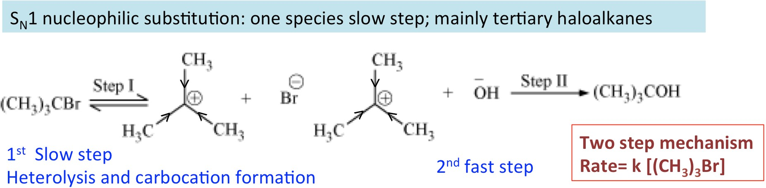
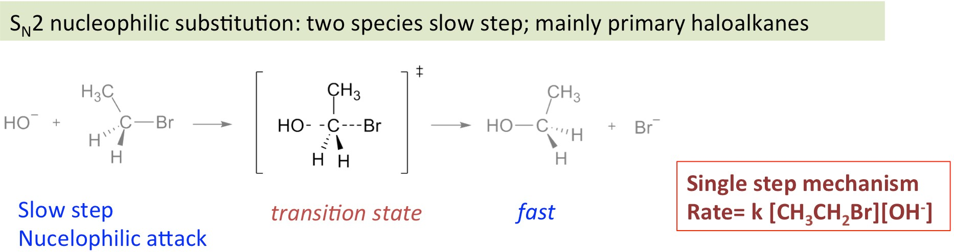

NUCLEOPHILIC SUBSTITUTION REACTION
SN¹ ( Unimolecular Nucleophilic Substitution )
Departure of leaving group takes place first , then the arrival of Nu⁻ takes place . It is two step reaction .
Rate is directly proportional to [ R-Lg ]¹ . Molecularity = 1
It follows 1st Order Kinetics .
Carbocation will form in 1st step and Rearrangement can be possible .
Note :- UP & DOWN attack possible at carbocation due to sp² hybridised centre . Note :- Inverted product dominated over Retented product .
SN² ( bimolecular Nucleophilic Substitution )
Departure of leaving group & arrival of Nu⁻ takes place simultaneously . It is one step reaction .
Rate is directly proportional to [ R-Lg ]¹ [ Nu⁻ ]¹ . Molecularity = 2
It follows 2nd Order Kinetics .
No carbocation will form , therefore no rearrangement .
Note :- Only INVERTED product will form .
Note :- Only back side attack is possible in case of SN² .

Slide 12
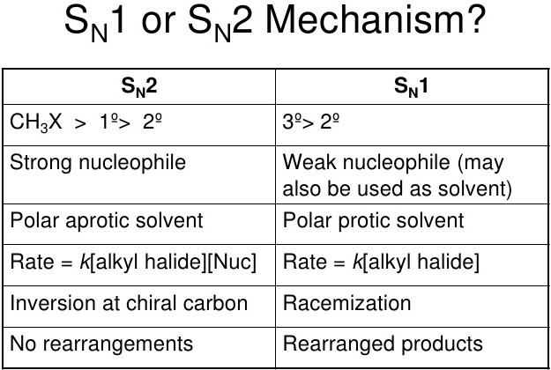

FACTOR AFFECTING
_{SN}1
& SN²
Nature of Alkyl Group Nature of Nucleophile Nature of Solvent Nature of Leaving Group
1. NATURE OF ALKYL GROUP
3^{O} > 2^{O} >> 1^{O}
1^{O} > 2^{O} >> 3^{O}
rate of SN¹ (stability
of carbocation)
rate of SN²
2. NATURE OF NUCLEOPHILE
Rate is directly proportional to [ R-Lg ]¹
High conc of weak Nu⁻ will favour SN¹ .
Rate is directly proportional to [ R-Lg ]¹ [ Nu⁻ ]¹ . High conc of strong Nu⁻ will favour SN² .
NATURE OF SOLVENT
Polar protic solvent favour SN¹ reaction . ( H2O ,C2H5-OH )
Polar aprotic solvent favour SN² reaction .
NATURE OF LEAVING GROUP
On the basis of leaving group we cann`t comment on SN¹ & SN² .
But for nucleophilc substitution reaction to take place leaving group should be
better .
In case of poor leaving group nucleophilic substitution rxn will not take place .

Slide 13

NUCLEOPHILIC SUBSTITUTION REACTION
WILLIAMSON ETHER SYNTHESIS
CH3-Cl + CH3-CH2-O-Na —————> CH3-O-CH2-CH3
FINKELESTIN HALOGEN EXCHANGE REACTION
CH3-CH2-Br + NaI (acetone) —————> CH3-CH2-I + NaBr
SWARTS HALOGEN EXCHANGE REACTION
CH3-CH2-Br + SbF3 (Metal + F) ————> CH3-CH2-F + SbBr3
REACTION OF PCl5 WITH CARBONYL
CH3-CH2-CO-CH3 + PCl5 —————> CH3-CH2-C(Cl)2-CH3 + O=PCl3
REACTION OF PCl5 WITH CARBOXYLIC ACID
CH3-CH2-COOH + PCl5 —————> CH3-CH2-CO-Cl + O=PCl3
REACTION OF PCl5 WITH ALCOHOL
CH3-CH2-OH + —————>
PCl5
CH3-CH2-Cl + O=PCl3
7. REACTION OF SOCl2 WITH ALCOHOL
CH3-CH2-OH + —————>
SOCl2 CH3-CH2-Cl + O=S=O + HCl
SOCl2 , HCl , (P+Cl2) , (SOCl2 + pyridene) will change
NOTE :- PCl5 , PCl3 ,
alcohol into respective halide .
HELL—VOLHARD—ZELINSKY REACTION
CH3-CH2-COOH + Br2 + RED P —————> CH3-CH(Br)-COOH + HBr
NOTE :- For H.V.Z rxn carboxylic acid should have atleast one alpha hydrogen .
REACTION OF ETHER WITH conc. HI
Ph-O-CH3 + conc. HI (limited / excess) ———> Ph-O-H + CH3-I
CH3-O-CH2-CH3 + conc. HI (limited) CH3-O-CH2-CH3 + conc. HI (excess) CH3-O-C-(CH3)3 + conc. HI (limited)
—————> CH3-CH2-OH + CH3-I
—————> CH3-CH2-I
—————> C-(CH3)3 -I
+ CH3-I
+ CH3-OH
CH3-O-C-(CH3)3 + anhyd HI (limited) —————> C-(CH3)3 -OH + CH3-I
NOTE :- In anhydrous condition carbocation can`t be formed, so the stricktly follow SN2 meachanism
WITTIG REACTION
CH3-CO-CH3 + Ph3P=C-R2 —————> (CH3)2C=CR2 + O=P(Ph)3
GENRAL REACTION OF ALKYL HALIDE
will
R-Cl R-Cl | + + | aq. KOH H2O | —————> —————> | R-OH R-OH | ( aqueous KOH work as Nu⁻ )
R-Cl | + | R`-O⁻Na⁺ | —————> | R-O-R` | ( Williamson Ether synthesis )
R-Cl | + | NH3 | —————> | R-NH2
R-Cl | + | R`-NH2 | —————> | R-NH-R`
R-Cl | + | R`2-NH | —————> | R-N-R`2
R-Cl | + | R`3-N | —————> | R4N⁺ Cl⁻ | ( Quaternary Salt )
R-Cl | + | K-CN | —————> | R-CN | ( Ionic )
R-Cl | + | Ag-CN | —————> | R-NC | ( Covalent )
R-Cl | + | K-O-N=O | —————> | R-O-N=O | ( Ionic ) ( Alkyl Nitrite )
R-Cl | + | Ag-O-N=O | —————> | R-NO2 | ( Covalent )
R-Cl | + | K-SH | —————> | R-SH
R-Cl | + | LiAlH4 | —————> | R-H | ( Reduction )
R-Cl + R`-Metal
—————> R-R` + Metal Halide

Slide 14
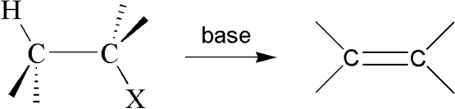
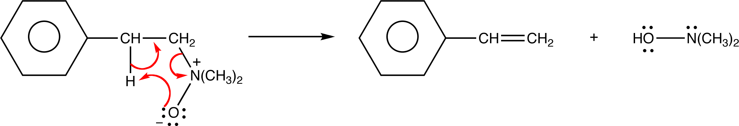

Elimination REACTION
( NOTE : - IN THIS CHAPTER WE LEARN TO FORM DOUBLE / TRIPLE BOND )
NOTE :- Elimination reaction is shown by a base
1. DEHYDROHALOGENATION OF ALKYL-HALIDE ( E2 elimination )
* It follows
E2
mechanism .
E2 follows ANTI elimination .
we can use alc. KOH as base .
2. DEHALOGENATION OF VICINAL DIHALIDE ( E2 elimination )
CH2Br—CH2Br + Zinc metal —————> CH2=CH2 + ZnBr
* It follows E2
mechanism .
* E2 follows ANTI elimination .
HOFMANN EXHAUSTIVE METHYLATION ( E2 elimination )
CH3-CH2-NH2 + CH3-I + moist AgO + K2CO3 —————> CH2=CH2 + N(CH3)3
( oxidising agent )
COPE ELIMINATION ( Ei )
It follows PERICYCLIC mechanism .
Reaction proceed via 5 member cyclic transition state .
Overall Reaction is SYN internal elimination .
PYROLYSIS OF ESTER ( Ei )
CH3-CO-O-CH2-CH3 + strong HEAT —————> CH2=CH2 + CH3-COOH
It follows PERICYCLIC mechanism .
Reaction proceed via 6 member cyclic transition state .
Overall Reaction is SYN internal elimination .
MENTOR :- JEETENDRA ARYA
MOB :- 7077 6066 22

Slide 15
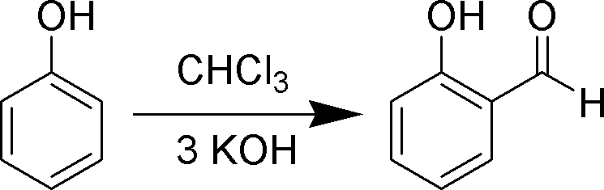
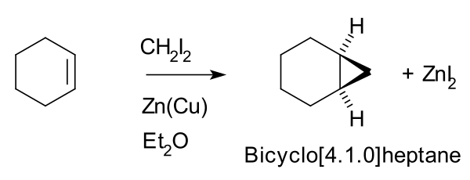


CARBENE
NOTE :- Generation of Carbene
1. By CHX3 + Base + Strong Heat
2. By Diazomethane
(CH2N2) * CH2N2
is a insertion group .
1. REIMMER - TIEMANN REACTION
* RTR always form ORTHO substituted product .
2. CARBYL AMINE REACTION ( HOFFMANN ISOCYANIDE RXN )
R-NH2 + CHCl3 + alc. KOH
* It is the test of 1º amine .
—————> R-NC
( Isocyanide )
3. SIMMON SMITH REACTION OF ZINC COUPLE
* It is steriospecific reaction .
4. REACTION WITH DIAZO-METHANE
R-CO-R` | + | CH2N2 | —————> | R-CO-CH2-R`
R-CHO | + | CH2N2 | —————> | CH3-CO-CH2-H
CH3COOH | + | CH2N2 | —————> | CH3-CO-O-CH2-H
H-Cl | + | CH2N2 | —————> | H-CH2-Cl
Ph-OH | + | CH2N2 | —————> | Ph-O-CH2-H
CH3-CH=CH-CH3 + |  | CH2N2 | —————> | 1,2 Dimethyl cyclopropane
5. ARNDT EISTERD HOMOGULATION OF ACID HALIDE
R-CO-Cl + CH2N2 + AgO + H3O+ ————> R-CH2-COOH
EXTRA :- THREE MEMBER RING CAN FORM BY DIAZOMETHANE
CH2=CH2 + CH2N2
—————> CYCLOPROPANE
MENTOR :- JEETENDRA ARYA
MOB :- 7077 6066 22

Slide 16
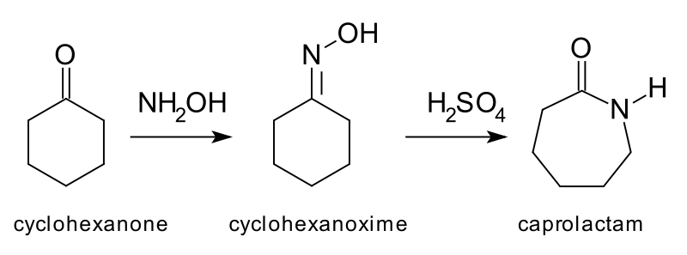
NITRENE
( NOTE : - IN THIS CHAPTER WE LEARN TO FORM AMINE )
HOFMANN BROMAMIDE DEGRADATION
R-CO-NH2 + Br2 + KOH —————> R-NH2
BECKMANN REARRANGEMENT
OXIME + H2SO4 —————> 2⁰ Amide
SCHMIDT REARRANGEMENT
R-CO-Cl + NaN3 —————> R-NH2
LOSSEN REARRANGEMENT
R-CO-NH-O-CO-R + KOH
5. CURTIUS REARRANGEMENT
R-CO-NH-NH2 + NaNO2 + dil.HCl
—————> R-NH2
—————>
R-NH2
TRICK OF NITRENE REACTION
E
HOFMANN BECK S LEEPER CLASS PEOPLE
EXTRA:- SEVEN
MEMBER RING CAN BE FORM BY BECKMANN REARRANGEMENT
THROUGH CYCLIC OXIME
MENTOR :- JEETENDRA ARYA
MOB :- 7077 6066 22

Slide 17
TEST OF UNSATURATION
BROMINE WATER TEST
Brown colour of Br2 decolourised .
BAEYER`S REAGENT TEST ( cold dil. alkaline KMnO4 )
Dark Pink / Violet colour of KMnO4 is decolourised by alkenes & alkynes and brown colour of MnO2 gets form .
TOLLEN`S REAGENT TEST
Only for terminal alkynes .
AMMONICAL CUPROUS CHLORIDE ( Cu2Cl2 + Base )
Only for terminal alkynes .
TEST OF ALCOHOL
ACTIVE METAL TEST
Alcohol produced H2 gas when it reacts with active metal like Na, K etc
CERRIC AMMONICAL NITRATE TEST ( C.A.N. TEST )
Alcohol gives red precipitation with CAN .
LUCAS TEST ( anhy. ZnCl2 + conc. HCl )
.
It is the test to distinguish between 1º, 2º, & 3º alcohol through turbidity .
ESTERIFICATION
When alcohol reacts with carboxylic acid produce fruity smell of ester .
VICTOR MEYER TEST ( P+I2 , AgNO3 , HO-N=O )
It is the test to distinguish between 1º, 2º, & 3º alcohol through colour .
f)
IODO-FORM TEST ( I2 + NaOH )
Some alcohols may give Iodoform test positive because of mild oxidising nature of NaOI . Iike ethanol, Isopropyl, Sec.butyl etc .
TEST OF CARBONYL
2,4- DNP TEST ( 2,4–Dinitrophenyl hydrazine )
Aldehyde & Ketone both will give red / orange / yellow precipitate with 2,4–D N P .
TOLLEN`S REAGENT TEST ( Silver Mirror Test )
It will distinguish between linear aldehyde & aromatic aldehyde from ketone .
FELHING TEST ( CuSO4 + Tartarate ions )
Only aliphatic aldehyde not aromatic aldehyde .
BENDICT`S TEST ( CuSO4 + Citrate ions )
Only aliphatic aldehyde not aromatic aldehyde .
SCHIFF`S TEST
Aldehyde restore the pink colour of schiff`s reagent .
IODO-FORM TEST
Given by some carbonyl compound and form yellow precipitate .
TEST OF CARBOXYLIC ACID
ACTIVE METAL TEST
Carboxylic acid produces H2 gas when it reacts with active metal like Na, K etc
ESTERIFICATION REACTION
When carboxylic acid reacts with alcohol, it produces fruity smell of ester .
NaHCO3
.
When —COOH reacts with NaHCO3 , CO2 gas will be librated from NaHCO3 with brisk- effervescence .
This test is given by compound which is more acidic than phenol .
e) LITMUS PAPER TEST
It will turn blue litmus paper into red .
MENTOR :- JEETENDRA ARYA
MOB :- 7077 6066 22

Slide 18

TEST OF PHENOL
ACTIVE METAL TEST
Phenol produced H2 gas when it reacts with active metal like Na, K etc
ESTERIFICATION REACTION
.
When Phenol reacts with carboxylic acid, it produces fruity smell of ester .
BROMINE WATER TEST
Phenol will form white ppt of 2,4,6-Tribromophenol .
NEUTRAL FeCl3
Phenol with neutral FeCl3 gives violet colour solution . Alcohol does not give this test .
LIEBERMANN NITROSO AMINE TEST
This is the only test of 2º amine but Phenol also gives this test +ve by forming indophenol (Red)
PHENOL + PTHALIC ACID ————> PHENOPTHALEIN
PHENOL NOT GIVES NaHCO3 TEST
This test is given by compound which is more acidic than phenol .
TEST OF AMINE
CARBYLAMINE TEST ( CHCl3 + alc. KOH )
The test is given by only 1º amine through pungent smell .
LIEBERMANN NITROSO AMINE TEST
The test is given by only 2º amine .
HOFMANN MUSTARD OIL TEST ( CS2 + HgCl2 )
CH3-NH2 + CS2 ——> CH3-NH-CS-SH + HgCl2 ——> CH3-N=C=S
( Isothiocyanide ) ( Musturd oil odour )
HINSBERG REAGENT TEST ( Benzene Sulphonyl Chloride )
It is the test for distinguish between 1º, 2º, & 3º amine through the solubilty of product in alkaline .
1º amine — soluble in alkaline 2º amine — insoluble in alkaline
3º amine — Benzene Sulphonyl Chloride does not react with 3º amine .
c) NaNO2 + dil. HCl in (0-5)ºC
1º amine + NaNO2 + dil. HCl in (0-5)ºC —> librate N2 gas .
2º amine + NaNO2 + dil. HCl in (0-5)ºC —> Nitrosoamine (Yellow colour)
3º amine + NaNO2 + dil. HCl in (0-5)ºC —> Salt
1º Aromatic amine + NaNO2 + dil. HCl in (0-5)ºC —> Diazonium salt + beta napthol —> red Dye
TEST OF CYANIDE & ISOCYANIDE
CYANIDE + REDUCING AGENT —————> 1º AMINE
CH3-CN + LiAlH4 ——> CH3-CH2-NH2
ISOCYANIDE + REDUCING AGENT —————> 2º AMINE
CH3-NC + LiAlH4 ——> CH3-NH-CH2
TEST OF PROTEIN, NITRO-GROUP, AMIDE & UREA
a) PROTEIN (AMINO-ACID) | ——> | NINHYDRIN TEST
b) NITRO GROUP | ——> | MULLIKEN`S TEST
c) AMIDE , UREA & PROTEIN | ——> | BIURET TEST
TEST OF CARBOHYDRATE
MOLISCH TEST
GLUCOSE AND FRUCTOSE GIVES BROMINE WATER TEST
MENTOR :- JEETENDRA ARYA
MOB :- 7077 6066 22

Slide 19
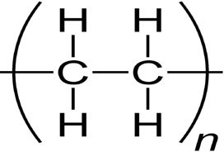
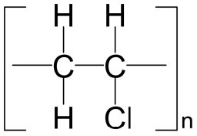
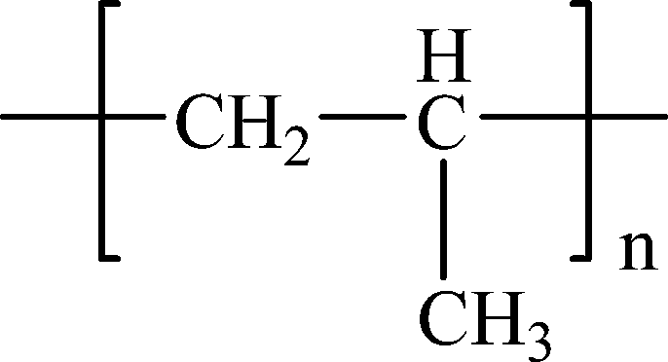
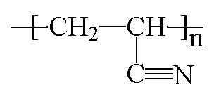
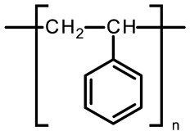
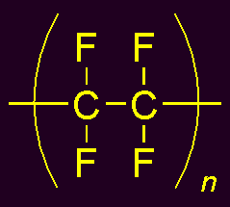
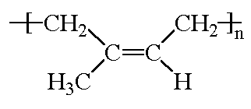
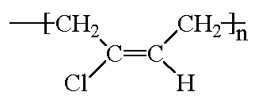
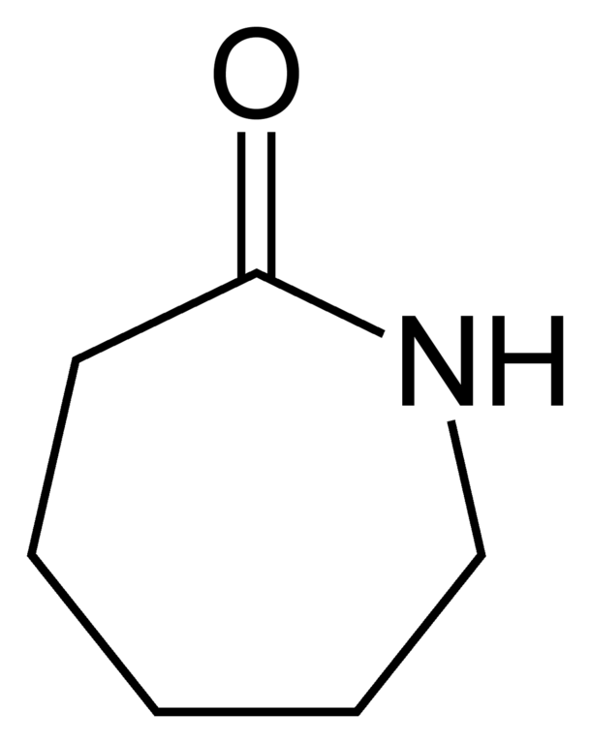
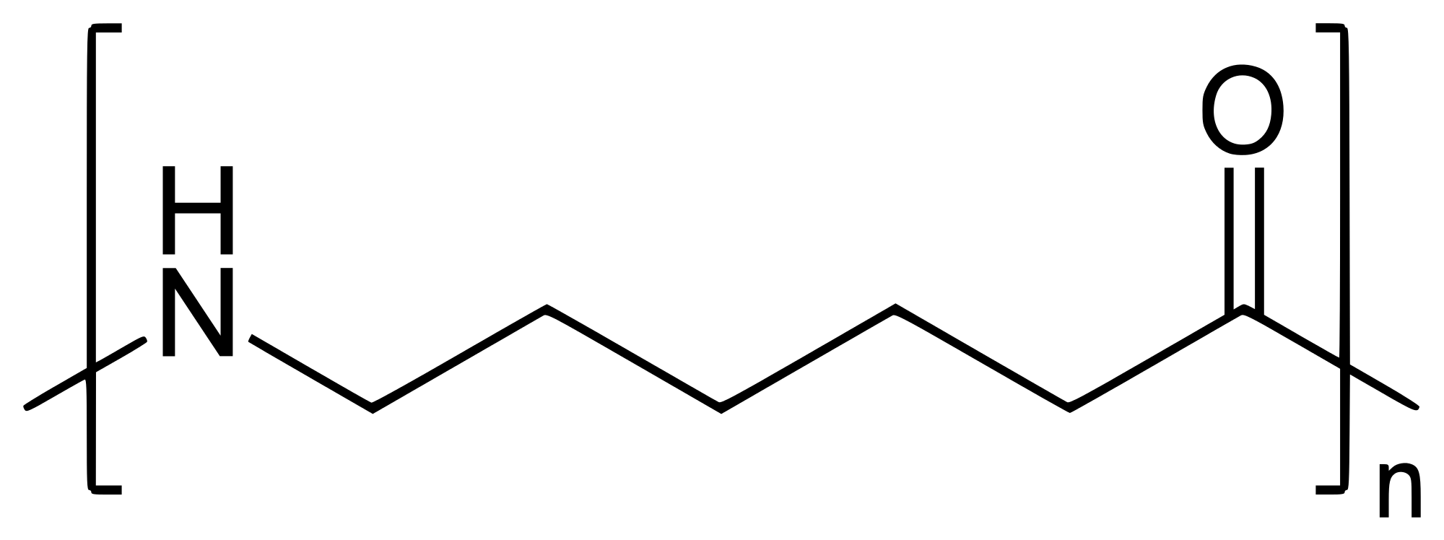
HOMOPOLYMER
Name of polymers | Monomer | Polymer | Uses
Polythene | CH2=CH2 |  | As insulator, anti corrosive, packing material
Polyvinylchloride | CH=CH2 Cl |  | In manufacture of raincoats , vinyl flooring , water pipes
Polypropylene | CH=CH2 CH3 |  | Reusable containers of various types, laboratory equipment, carpets, loudspeakers
Polyacrylonitrile (Orlon) | CH=CH2 CN |  | In making synthetic wool & fibres
Polystyrene | CH=CH2 Ph |  | As insulator, manufacture of toys
Polytetrafluoroethylene (PTFE) (Teflon) | CF2=CF2 |  | As insulator, lubricant, making of cooking wares
(Natur Rubber ) Cis-Isoprene | CH3 CH2=C—CH=CH2 |  | In making of tyres
Neoprene | Cl CH2=C—CH=CH2 |  | As insulator, conveyor belts, printing roller
Nylon-6 (Caprolactam) |  |  | In making ropes , tyre cord, fibres

Slide 20
HOMOPOLYMER
Name of polymers | Monomer | Polymer | Uses
Polythene | CH2=CH2 |  | As insulator, anti corrosive, packing material
Polyvinylchloride | CH=CH2 Cl |  | In manufacture of raincoats , vinyl flooring , water pipes
Polypropylene | CH=CH2 CH3 |  | Reusable containers of various types, laboratory equipment, carpets, loudspeakers
Polyacrylonitrile (Orlon) | CH=CH2 CN |  | In making synthetic wool & fibres
Polystyrene | CH=CH2 Ph |  | As insulator, manufacture of toys
Polytetrafluoroethylene (PTFE) (Teflon) | CF2=CF2 |  | As insulator, lubricant, making of cooking wares
(Natur Rubber ) Cis-Isoprene | CH3 CH2=C—CH=CH2 |  | In making of tyres
Neoprene | Cl CH2=C—CH=CH2 |  | As insulator, conveyor belts, printing roller
Nylon-6 (Caprolactam) |  |  | In making ropes , tyre cord, fibres

Slide 21

NOTES
k

